Slide 1

Operating Systems
Jinghui Zhong （钟竞辉）
Office：B3-515
Email ：jinghuizhong@scut.edu.cn

Slide 2

单选题
1分
In order to support fast random play of video files in CD-ROM, the best way to organize file data blocks is
A
Contiguous allocation
B
Linked List
C
FAT
D
I-node
提交

Slide 3
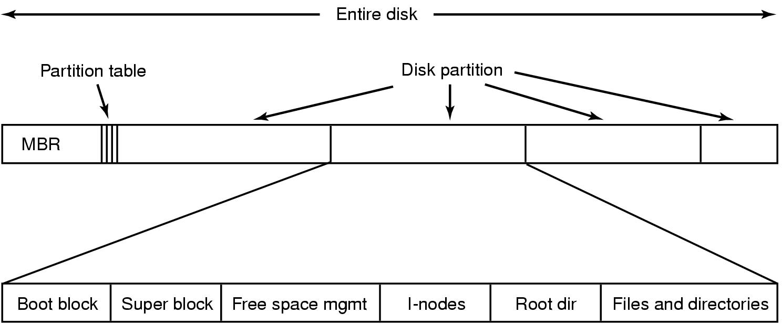
File System Layout
File system layout:
MBR (Master Boot Record) is used to boot the computer.
The partition table gives the starting and ending addresses of each partition.
3

Slide 4
File System Layout
Boot block: read in by the MBR program when the system is booted.
Superblock: contains the key parameters about the file system.
Free blocks information
I-nodes tells all about the file.
Root directory
Directories and files
Load OS
4

Slide 5
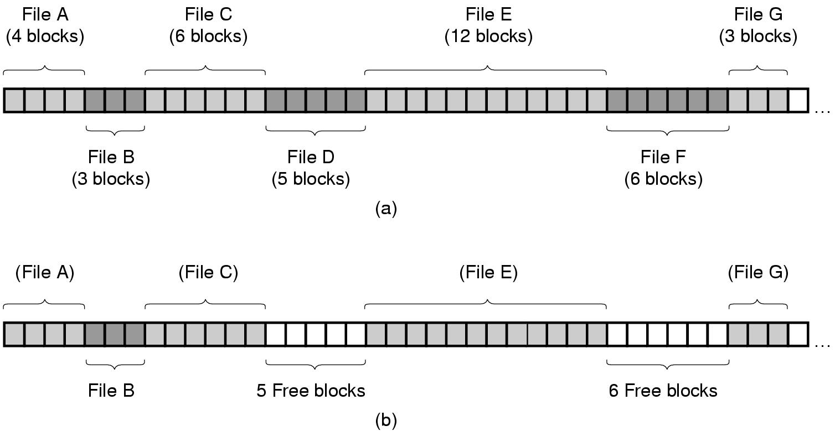
File Allocation
Contiguous Allocation:
store each file as contiguous block of data.
5

Slide 6
File Allocation
Contiguous Allocation
Advantages:
Simple to implement;
Read performance is excellent.
Disadvantages:
Disk fragmentation
The maximum file size must be known when file is created.
Example: CD-ROMs, DVDs
6

Slide 7
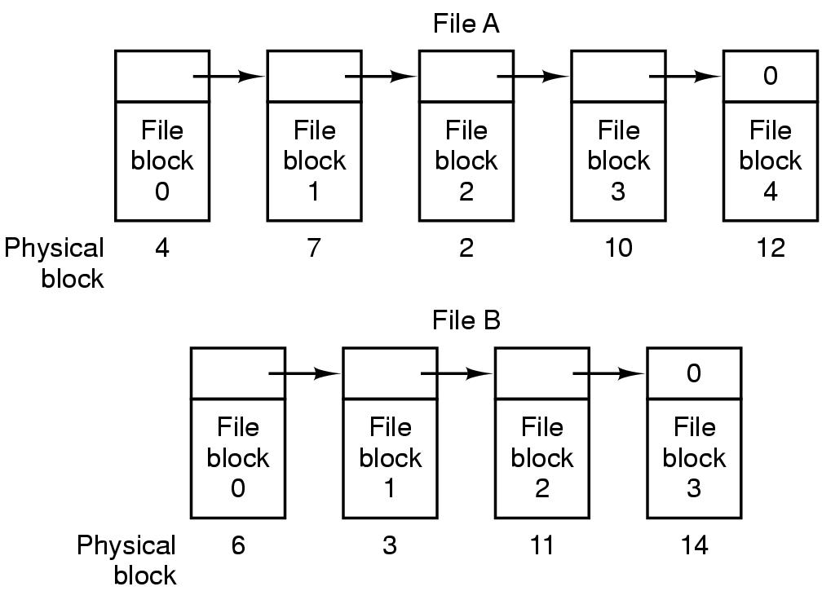
File Allocation
Linked List Allocation:
keep linked list of disk blocks
Disadvantages ?
Slow random access speed
The amount of data in a block is not a power of 2
7

Slide 8
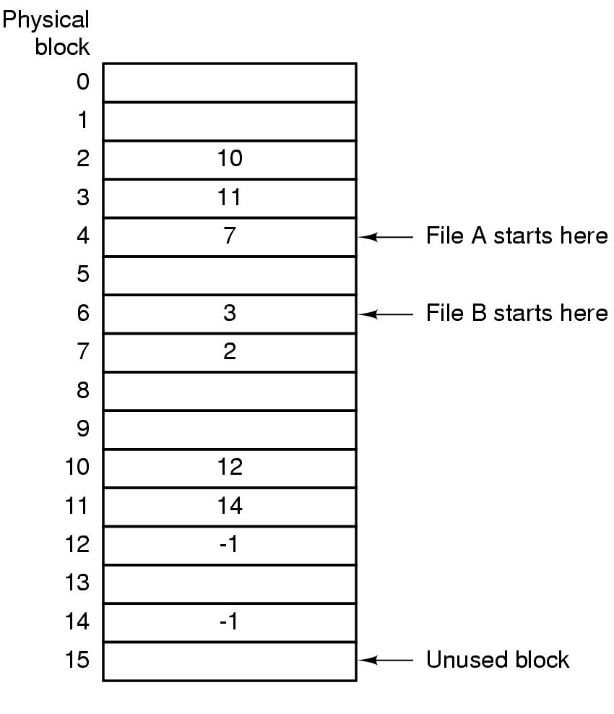
Linked List Allocation using an index
Take table pointer word from each block and put them in an index table, FAT (File Allocation Table) in memory.
Advantages?
The entire block is available for data
Stored in memory, fast
Drawbacks?
Occupies a large amount of memory.
For 200-GB disk, the table will take up 600M or 800 M memory.
8

Slide 9
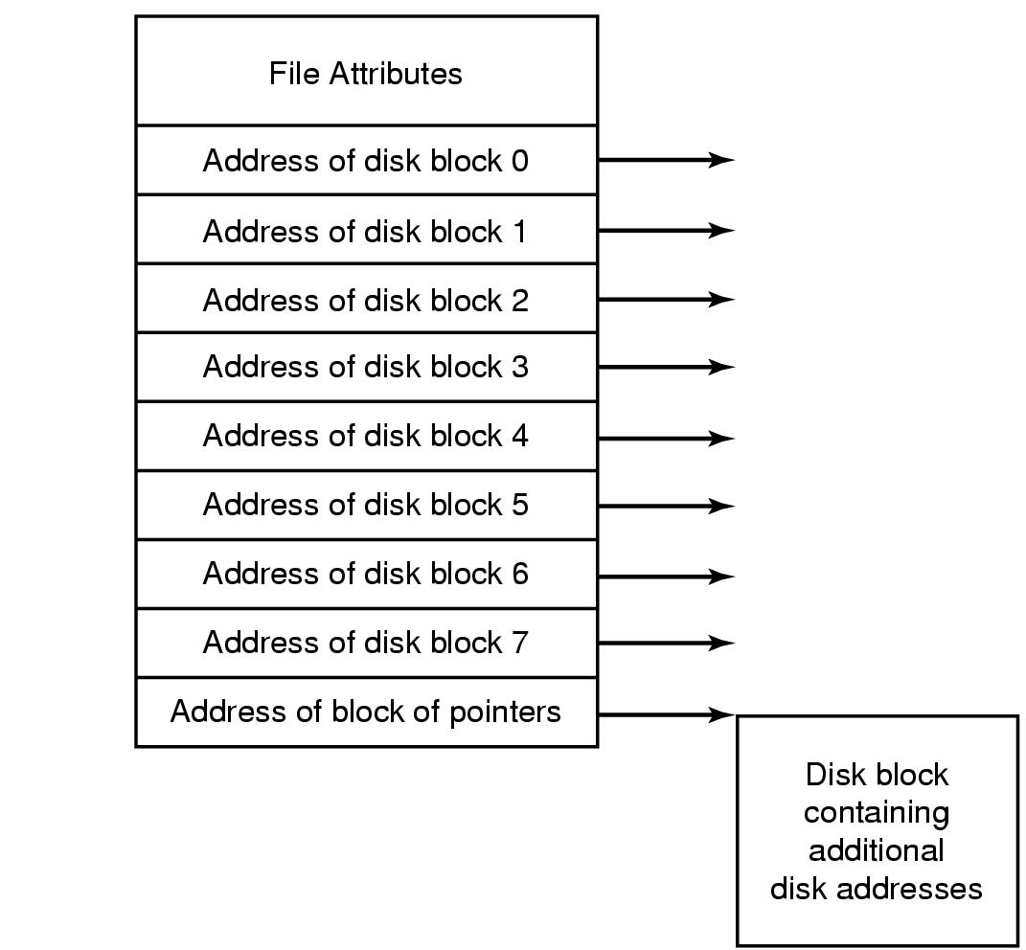
File System Implementation
I-node (index-node):
lists the attributes and disk addresses of the file's blocks.
9

Slide 10
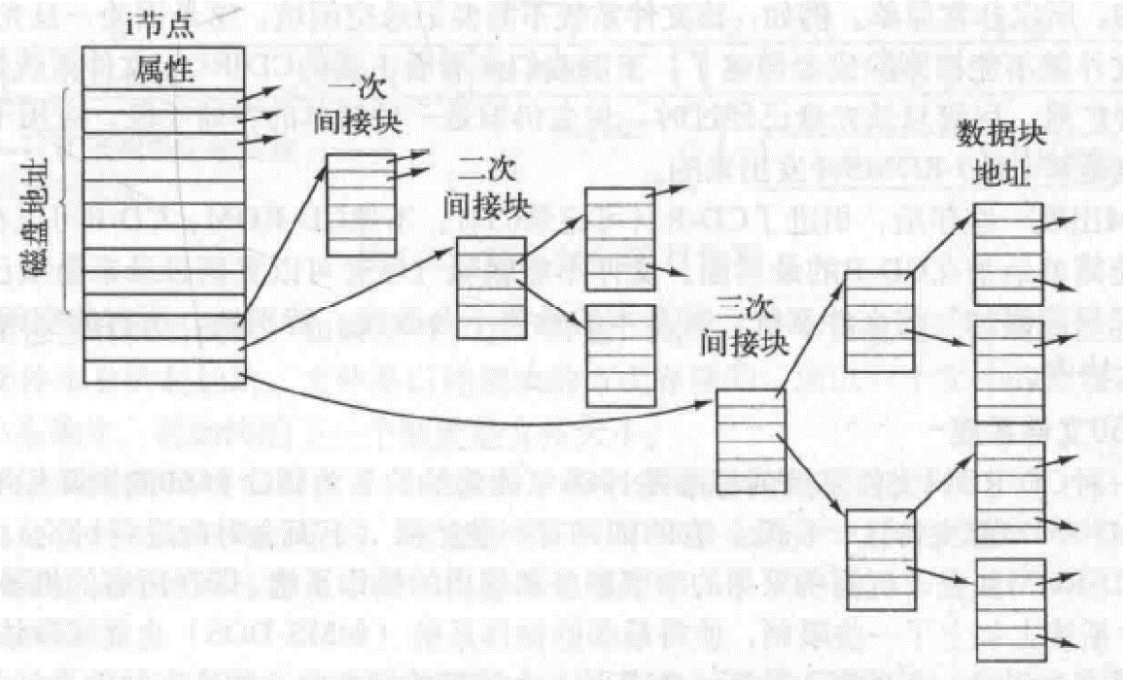
主观题
1分
Consider the I-node as shown in the figure below. It contains 10 direct address entries, one primary indirect block, one secondary indirect block, and one tertiary indirect block. Moreover, the disk address is represented by 4 bytes, and the size of all disk blocks is 4KB. What is the maximum possible size of the file ？
正常使用主观题需2.0以上版本雨课堂
作答

Slide 11
Consider the I-node as shown in the figure below. It contains 10 direct address entries, one primary indirect block, one secondary indirect block, and one tertiary indirect block. Moreover, the disk address is represented by 4 bytes, and the size of all disk blocks is 4KB. What is the maximum possible size of the file ？
Answer：
10 direct address entries: 10 pointers；
One primary indirect block: 1024 pointers；
One secondary indirect block: 1024*1024 pointers；
One tertiary indirect block: 1024*1024*1024 pointers；
The maximum size = (10+1024+1024²+1024³）*4KB

Slide 12
Directories
When a file is opened, the file system uses the path name to locate the directory entry.
Directory: provides information needed to find the disk blocks.
disk address of the entire file (contiguous blocks)
the number of first block (linked list)
the number of I-node (I-node)
Where to store attributes? In directory or I-node?
12

Slide 13
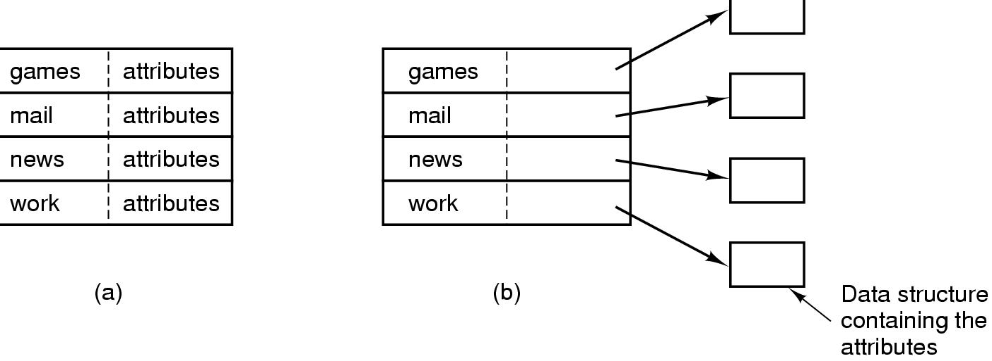
Directories
Two methods to store attributes
Fixed size entries, disk addresses and attributes in directory entry (MS-DOS/Windows)
Directory in which each entry just refers to an I-node (UNIX)
13

Slide 14
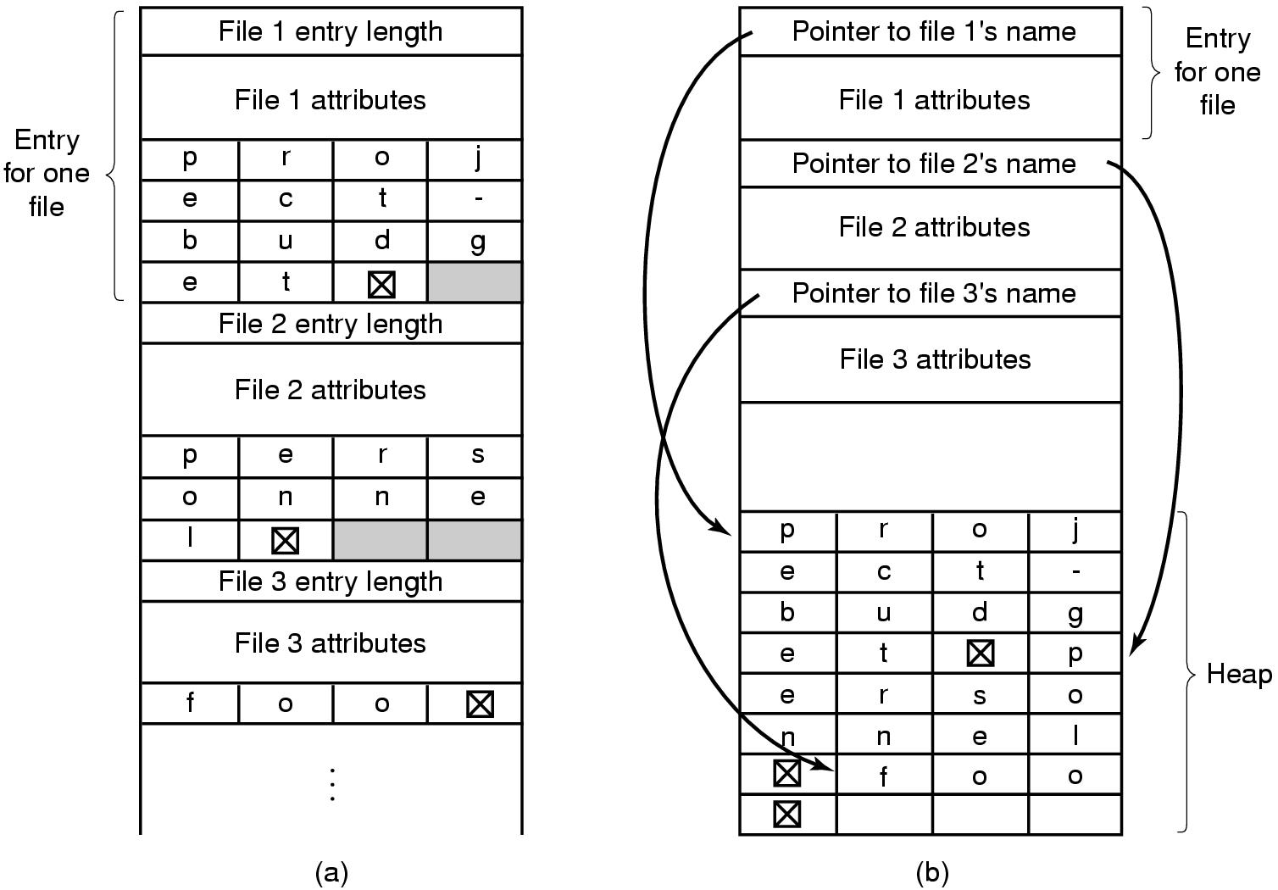
Implementation directories
Handling long file names in a directory:
Fixed-length names (Waste space)
In-line (When a file is removed, a variable-sized gap is introduced., see(a))
Heap (The heap management needs extra effort, see (b))
14

Slide 15
Implementation directories
How to search files in each directory?
Linearly (slow)
Hash table (faster lookup but more complex administration)
Cache the results of searches
15

Slide 16
单选题
1分
In the process of deleting a file, the operation that the operating system cannot perform is （）
A
Delete the directory where this file is located
B
Delete the directory entry associated with this file
C
Delete the file control block corresponding to this file
D
Free the memory buffer associated with this file
提交

Slide 17
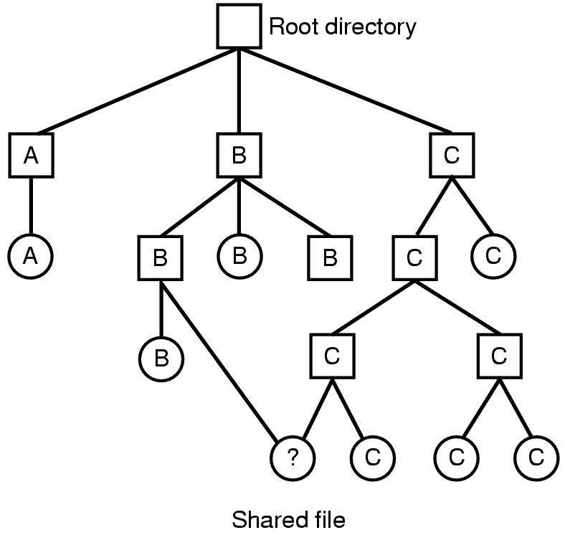
Shared files
A shared file is used to allow a file to appear in several directories.
The connection between a directory and the shared file is called a link. The file system is a Directed Acyclic Graph (DAG).
17

Slide 18
Shared files
Problem:
If directories contain disk address, a copy of the disk address will have to be made in directory B. What if A or B append the file, the new blocks will only appear in one directory.
Solution:
Do not list disk block addresses in directories but in a little data structure. e.g., i-nodes
Create a new file of type link which contains the path name of the file to which it is linked ➔ symbolic linking
18

Slide 19


Slide 20
Virtual File Systems
Definition: the Virtual File System (or the Virtual Filesystem Switch) is the software layer in the kernel that provides the filesystem interface to user space programs.
From "the" filesystem to many filesystem types
Examples – Ext2, UFS(Solaris), NFS, Ext3, Veritas, ReiserFS, XFS, ISO9660 (CD), UDF (DVD) etc.

Slide 21
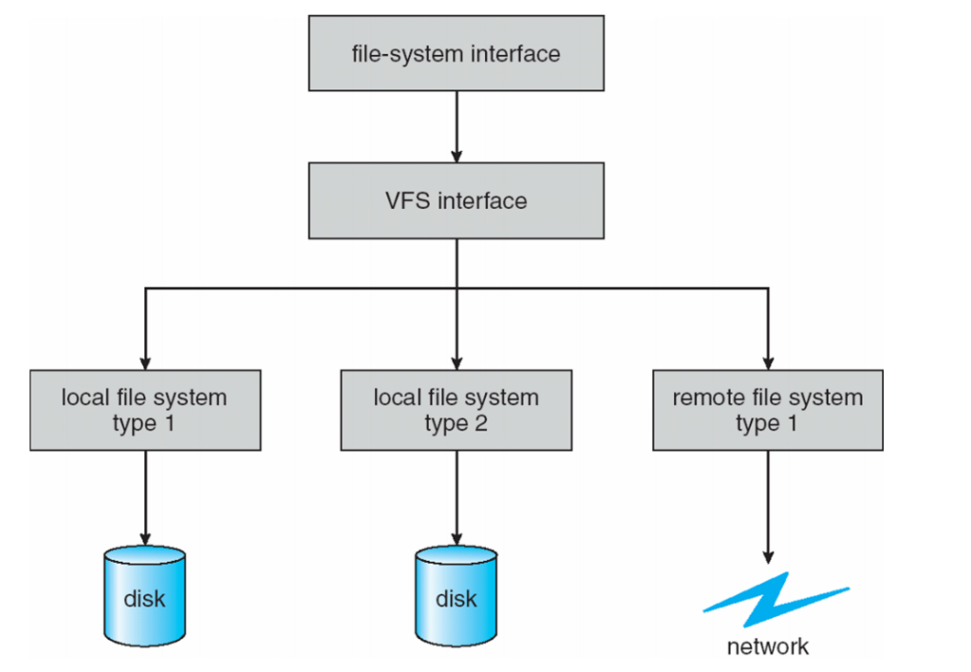
Virtual File Systems
Same API for different types of file systems
Separates file-system generic operations from implementation details
Syscalls program to VFS API rather than specific FS interface
Very flexible use cases:
User files remote and system files local?
Boot from USB? Network?

Slide 22
主观题
1分
For the file： /usr/ast/courses/os/handout.t, How many disk operations are needed to get its I-node? Assume that the I-node of its root directory is in memory, and no other path is in memory.
正常使用主观题需2.0以上版本雨课堂
作答

Slide 23
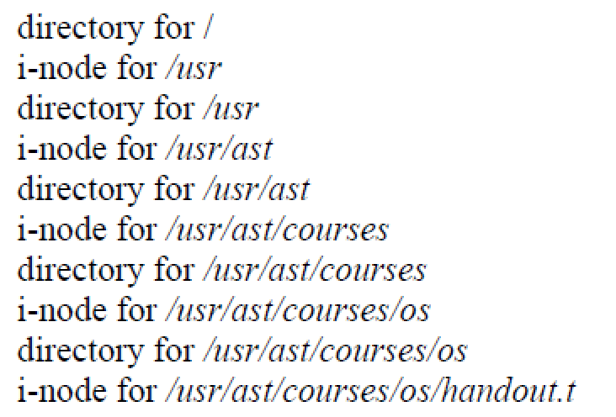
For the file： /usr/ast/courses/os/handout.t, How many disk operations are needed to get its I-node? Assume that the I-node of its root directory is in memory, and no other path is in memory.
Answer：
Thus, there are totally 10 disk operations。

Slide 24
多选题
1分
Which is one of the function of file system? ()
A
Make it easy to use information
B
Protecting information
C
Provide means of sharing information
D
Drive external devices
E
Allocate disk space
提交

Slide 25
Disk space management
Strategies for storing an n byte file:
Allocate n consecutive bytes of disk space
If the file grows it will have to be moved on the disk, it is an expensive operation and causes external fragmentation.
Allocate a number [n/k] blocks of size k bytes each
Blocks do not need to be adjacent.
25

Slide 26
How to determine block size？
When block size increase, disk space utilization decrease
Internal fragmentation, space efficiency decrease
When block size decrease, data transfer rate decrease
Time efficiency decrease
usual size k = 512bytes, 1k (UNIX), or 2k
26

Slide 27
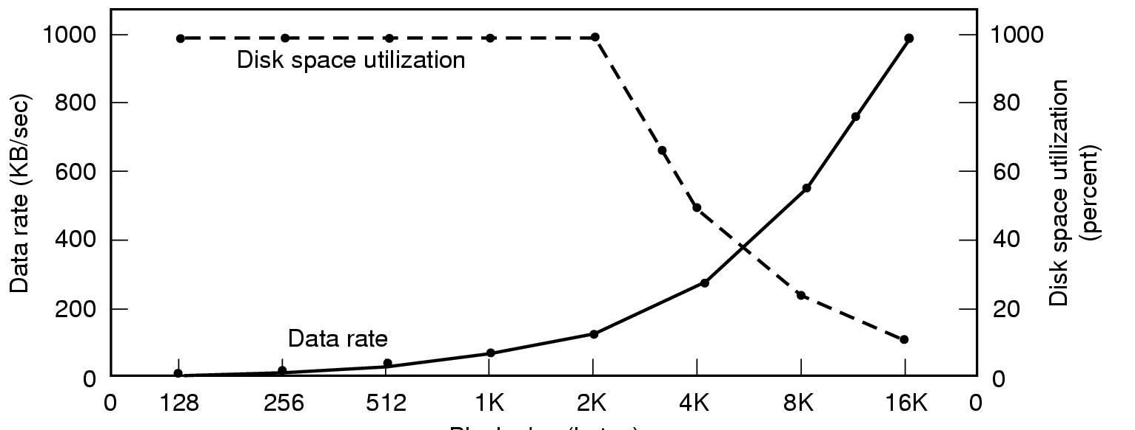
Disk Space Management
Block size
Dark line gives data rate of a disk
Dotted line gives disk space efficiency (The size of each file is 2K)
27

Slide 28
Keeping Track of Free Blocks
Use bit-map: Free blocks ->1, Allocated blocks -> 0
A disk with (n) blocks requires a bitmap with (n) bits
Free blocks are represented by 1's
Allocated blocks represented by 0's
16GB disk has 2²⁴ 1-KB and requires 2²⁴ bits ➔ 2048 blocks
Using a linked list = 2²⁴/255 = 65793 blocks.
28

Slide 29
Keeping Track of Free Blocks
Use linked list of disk blocks:
With 1 KB block and 32-bit disk block number.
Each block holds as many free disk block numbers as will fit. ➔ 1024 * 8/32 = 256 disk block numbers ➔ 255 free blocks (and) 1 next block pointer.
29

Slide 30
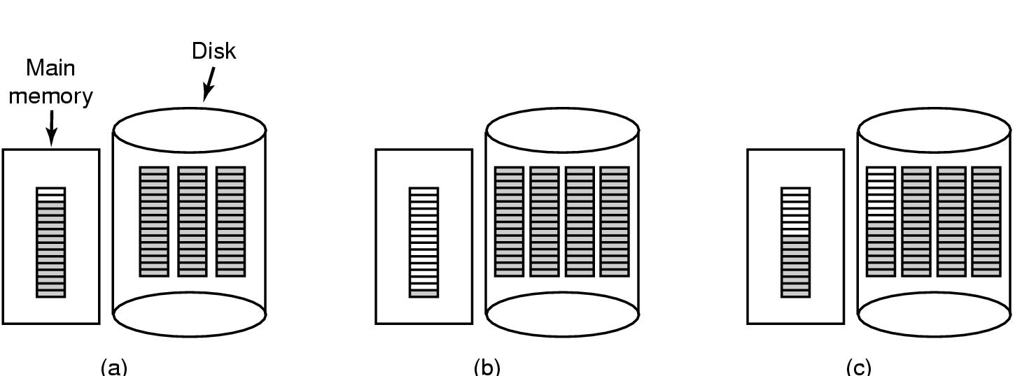
Disk Space Management
(a) Almost-full block of pointers to free disk blocks in RAM
- three blocks of pointers on disk
(b) Result of freeing a 3-block file
(c) Alternative strategy for handling 3 free blocks
- Keep the one in memory about half full.
30

Slide 31
主观题
10分
Free disk space can be kept track of using a free list or a bitmap. Disk addresses require D bits. For a disk with B blocks, F of which are free, state the condition under which the free list uses less space than the bitmap. For D having the value 16 bits, express your answer as a percentage of the disk space that must be free.
正常使用主观题需2.0以上版本雨课堂
作答

Slide 32
Free disk space can be kept track of using a free list or a bitmap. Disk addresses require D bits. For a disk with B blocks, F of which are free, state the condition under which the free list uses less space than the bitmap. For D having the value 16 bits, express your answer as a percentage of the disk space that must be free.
Answer: D * F < B
→ F/B < 1/D

Slide 33
主观题
1分
Suppose a disk has 100 cylinders, each cylinder has 16 tracks, and each track is divided into 4 blocks. 1) How many storage blocks are there in the whole disk space? 2) How many words are needed to construct a bitmap for free space management, suppose each word has 32-bits? 3) What is the block number corresponding to the 16th bit of the 18th word in the bitmap?
正常使用主观题需2.0以上版本雨课堂
作答

Slide 34
Suppose a disk has 100 cylinders, each cylinder has 16 tracks, and each track is divided into 4 blocks.
How many storage blocks are there in the whole disk space?
How many words are needed to construct a bitmap for free space management, suppose each word has 32-bits?
What is the block number corresponding to the 16th bit of the 18th word in the bitmap?
Answer:
The total storage blocks = 100 * 16 * 4 = 6400;
6400/32 = 200 words;
17 * 32 + 16 = 560;

Slide 35
File System Backup
Backups are made to handle: recover from disaster or stupidity.
Considerations of backups
Entire or part of the file system
Incremental dumps: dump only files that have changed
Compression
Backup an active file system
Security
35

Slide 36
File System Backup
Two strategies for dumping a disk:
Physical dump: starts at block 0 to the last one.
Advantages: simple and fast
Disadvantages: backup everything
Logical dump: starts at one or more specified directories and recursively dumps all files and directories found that have changed since some given base date.
36

Slide 37


Slide 38
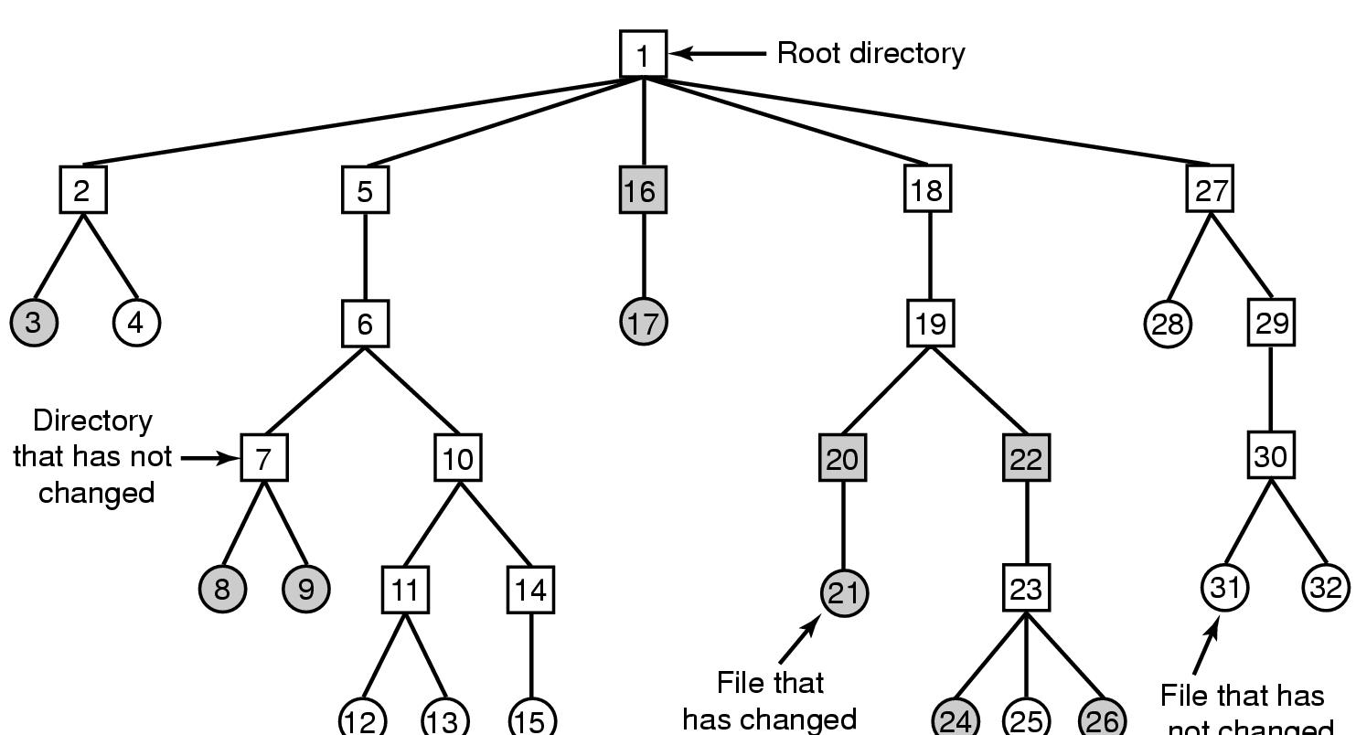
File System Backup
File that has
not changed
A file system to be dumped (squares are directories, circles are files,
shaded items are modified since last dump, each directory & file labeled by i-node number
38

Slide 39
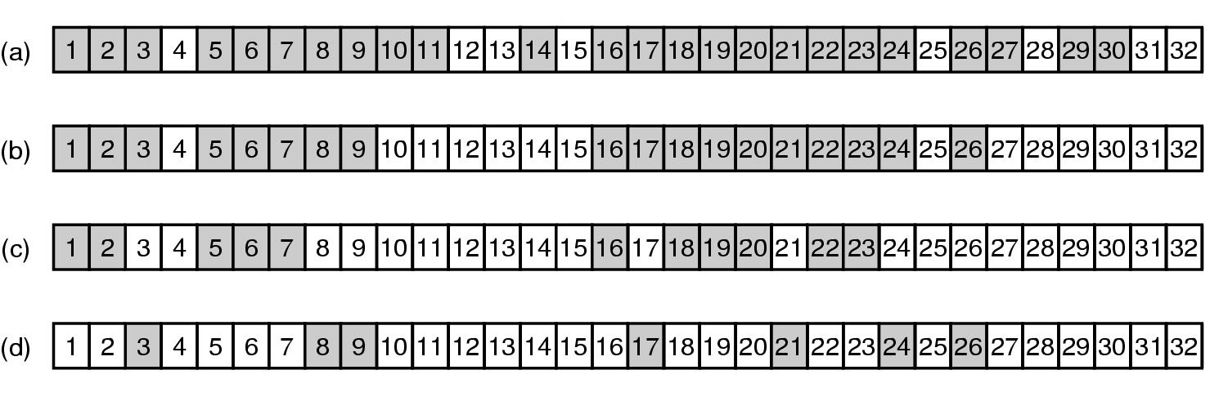
File System Backup
Bit maps used by the logical dumping algorithm
(After 4 phases, the dump is complete)
39

Slide 40
File System Consistency
Most OS have a utility program, called a file system checker, to test the consistency of a file system.
E.g., fsck in UNIX, sfc in Windows
Two types of consistency checks can be made:
(a) block consistency
(b) file consistency
40

Slide 41
File System Consistency
Block consistency:
Build two tables with a counter per block, initially set to 0 , The counters in the first table keep track of number of times each block is present in a file. The counters of the second table record the number of times in free list,
Then, the program reads all the i-nodes and uses the i-nodes to build a list of all blocks used in the files (incrementing file counter as each block is read).
Check free list or bit map to find all blocks not in use (increment free list counter for each block in free list).
41

Slide 42
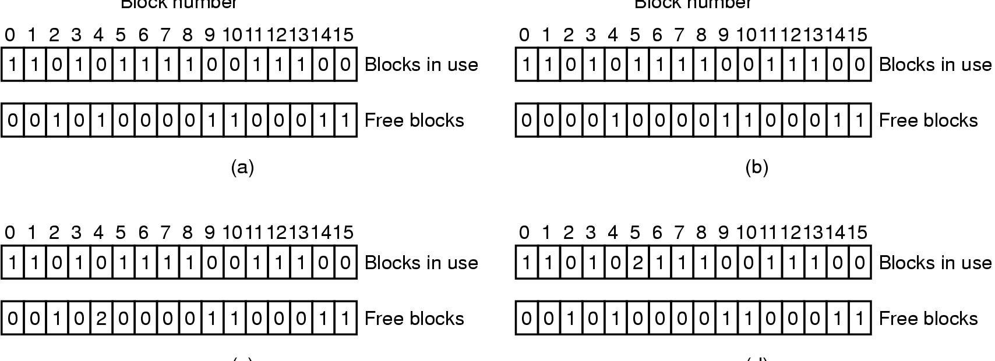
File System Consistency
(c)
(d)
File system states
(a) consistent
(b) missing block – add it to the free list
(c) duplicate block in free list – rebuild the free list
(d) duplicate data block – copy the block to a free block
42

Slide 43
File System Consistency
For checking directories – keep a list of counters per file starting at the root directory, recursively inspect each directory. For each file, increment the counter for the files i-node
Compare computed value with link count stored in each i-node.
i-node link count > computed value = number of directory entries.
Even if all files are removed, the i-node link count > 0. So the i-node will not be removed.
Solution : set i-node link count = value computed
i-node link count < computed value
The i-node may be freed even when there is another directory points to it
directory will be pointing to unused i-node
solution : set inode link count = computed value
43

Slide 44
主观题
1分
What happens if the free block table or bitmap that stores the information about the free disk block is completely lost due to the system crash? Is the disk completely unusable?
正常使用主观题需2.0以上版本雨课堂
作答

Slide 45
What happens if the free block table or bitmap that stores the information about the free disk block is completely lost due to the system crash? Is the disk completely unusable?
Answer： It will make the system unable to find free blocks to store new data. The solution is to rebuild the free block table or bitmap by scanning the file system related information (such as the I-nodes of all files).

Slide 46
主观题
1分
A certain file system uses 2KB disk blocks. The median file size is 1KB. If all files were exactly 1 KB, what fraction of the disk space would be wasted? Do you think the wastage for a real file system will be higher than this number or lower than it? Explain your answer.
正常使用主观题需2.0以上版本雨课堂
作答

Slide 47
A certain file system uses 2KB disk blocks. The median file size is 1KB. If all files were exactly 1 KB, what fraction of the disk space would be wasted? Do you think the wastage for a real file system will be higher than this number or lower than it? Explain your answer.
Answer： Each block wastes 1KB, so a total of 50% of the disk space is wasted; the commonly used file system contains a large number of files larger than 2KB, so the space wasted is usually smaller than this value.

Slide 48
Check Points
Please describe the advantages and disadvantages of contiguous allocation.
Please describe the advantages and disadvantages of linked listed allocation.
Please describe the advantages and disadvantages of FAT.
Please describe the two methods for keeping tracks of free blocks.
Please describe the two strategies for dumping a disk.
Please describe the two types of consistency checks .
48

